Slide 1
TETRA
Inclusief toerisme als
businesstransformator
voor kleinschalige logies en toeleveringsbedrijven

Slide 2
Agenda
Welkomstwoord Hogeschool PXL en Uhasselt
Pete Kercher - Kader en praktijkvoorbeelden van Design for all
Panelgesprek – Uitdagingen Design for all
Toelichting Tetra-project – Inclusief toerisme als businesstransformator
Vraag en antwoord
Receptie en netwerking

Slide 3
1. Verwelkoming
Door Evi Knuts,
Onderzoekshoofd PXL Expertisecentrum Innovatief ondernemen
Prof. dr. Jan Vanrie,
Vicedirecteur Doctoral Schools behavioral Sciences and Humanities

Slide 4
2. Kader en praktijkvoorbeelden
Door Pete Kercher,
Medegrondlegger van Design for All Europe (EIDD, 1993)

Slide 5
Why Design for All? Tetra Project Kick-off University of Hasselt 05 November 2019
Pete Kercher – Ambassador, EIDD – Design for All Europe
Consultant in Strategic Design

Slide 6
Established in Dublin in 1993 as the European Institute for Design and Disability
EIDD – DESIGN FOR ALL EUROPE
ENHANCING THE QUALITY OF LIFE THROUGH DESIGN FOR ALL
Pete Kercher – Hasselt – 05 November 2019

Slide 7
EIDD – Design for All Europe 39 members in 18 European states and now 1 in Australia, head office in Austria:
- DfA associations - designer associations - design promotion centres
- creativity and innovation centres
- schools and universities
- associations of people with disabilities
- foundations - cities
- design museums and institutes
Pete Kercher – Hasselt – 05 November 2019

Slide 8
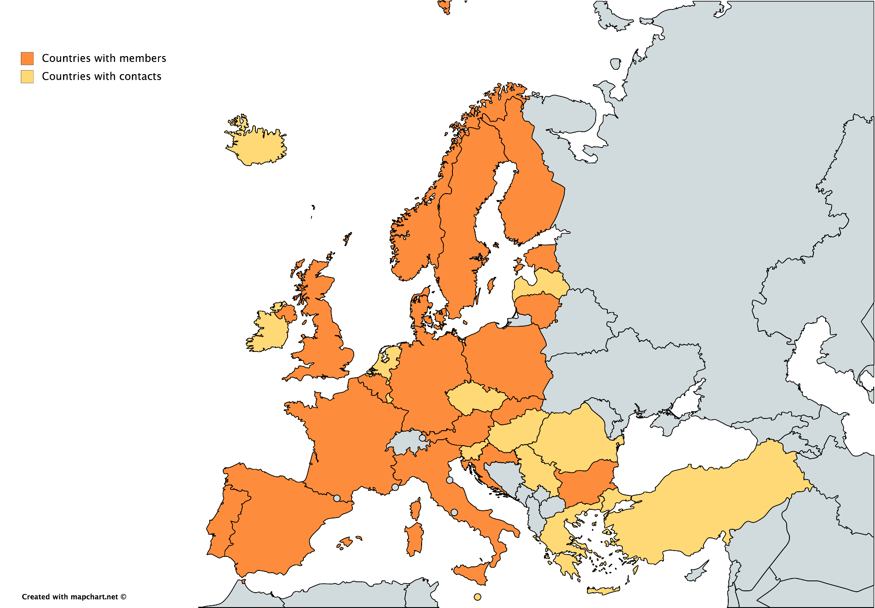
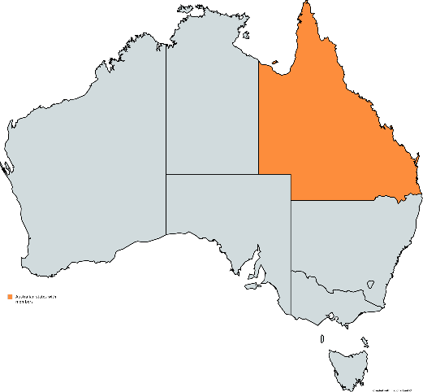
Pete Kercher – Hasselt – 05 November 2019

Slide 9
Design for All in Academia EIDD has created an Academic Network (ACANET), whose members all over Europe collaborate on academic issues http://dfaeurope.eu/about-members/working-groups/dfa-acanet-2/ AHFE Conference on Design for Inclusion, USA, since 2016 http://ahfe2020.org
Pete Kercher – Hasselt – 05 November 2019

Slide 10
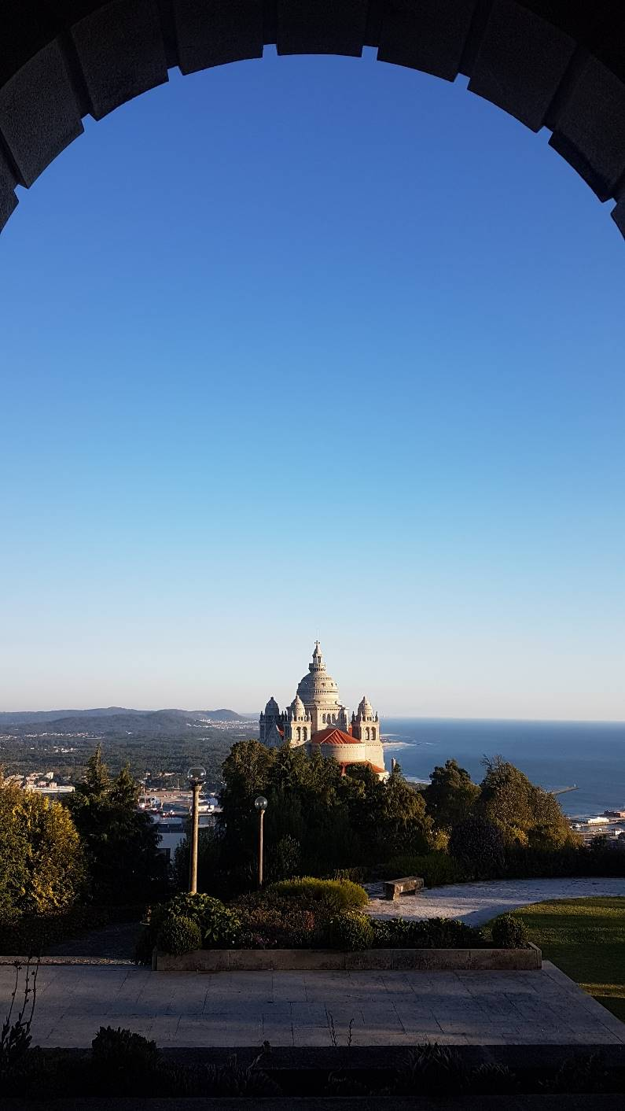
EIDD Summer School Viana do Castelo Portugal 8-13 September 2019
Pete Kercher – Hasselt – 05 November 2019

Slide 11
What is this all about? Dispelling some myths: It's about inclusion, but not (only) disability It's about humanity, but not (only) caring for "others" It's about design, but not (only) tables and chairs it’s about culture, but not (only) art It’s about return on investment, but not (only) economics
Pete Kercher – Hasselt – 05 November 2019

Slide 12
It’s about identifying the challenges facing design today and tomorrow: increasing human diversity: abilities, ageing, (im)migration… … and using design, holistically, to face them
Pete Kercher – Hasselt – 05 November 2019

Slide 13
Those challenges include disability and ageing Disability and ageing are not watertight containers, but part of the social inclusion agenda.
Pete Kercher – Hasselt – 05 November 2019

Slide 14
So let’s start by understanding disability Please stand up
Pete Kercher – Hasselt – 05 November 2019

Slide 15
What’s that got to do with design? What exactly is Design for All?
Pete Kercher – Hasselt – 05 November 2019

Slide 16
Paul Hogan President Emeritus EIDD 1993
Pete Kercher – Hasselt – 05 November 2019
www.iccaworld.com

Slide 17
Design for All is design for human diversity, social inclusion and equality. Source: EIDD Stockholm Declaration© 2004 – www.dfaeurope.eu
Pete Kercher – Hasselt – 05 November 2019

Slide 18
Pete Kercher – Hasselt – 05 November 2019

Slide 19
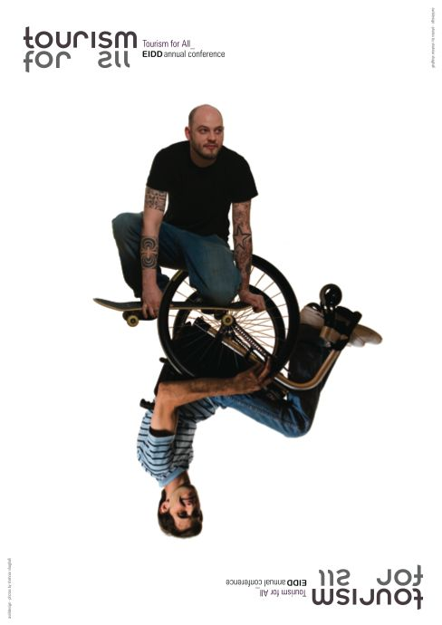
Pete Kercher – Hasselt – 05 November 2019

Slide 20
Pete Kercher – Hasselt – 05 November 2019

Slide 21
Pete Kercher – Hasselt – 05 November 2019

Slide 22
Pete Kercher – Hasselt – 05 November 2019

Slide 23
Pete Kercher – Hasselt – 05 November 2019

Slide 24
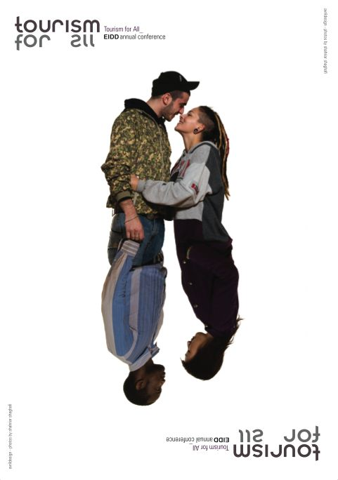
Pete Kercher – Hasselt – 05 November 2019

Slide 25
Pete Kercher – Hasselt – 05 November 2019

Slide 26
Pete Kercher – Hasselt – 05 November 2019

Slide 27
“The practice of Design for All makes conscious use of the analysis of human needs and aspirations and requires the involvement of end users at every stage in the design process.” Source: EIDD Stockholm Declaration© 2004 – www.dfaeurope.eu
Pete Kercher – Hasselt – 05 November 2019

Slide 28
The classical design responses to identifiable categories consist in what we call “add-on” approaches: a special adjustment is made to an existing environment, product, communication or service so that it will also be accessible to the members of that given category.
Pete Kercher – Hasselt – 05 November 2019

Slide 29
Examples: - Special versions of software for blind users - Temporary (and often quite unstable) ramps in exhibitions - Horrendous “standard” bathrooms for a mythical “third gender” In terms of economics, it makes no sense.
Pete Kercher – Hasselt – 05 November 2019

Slide 30
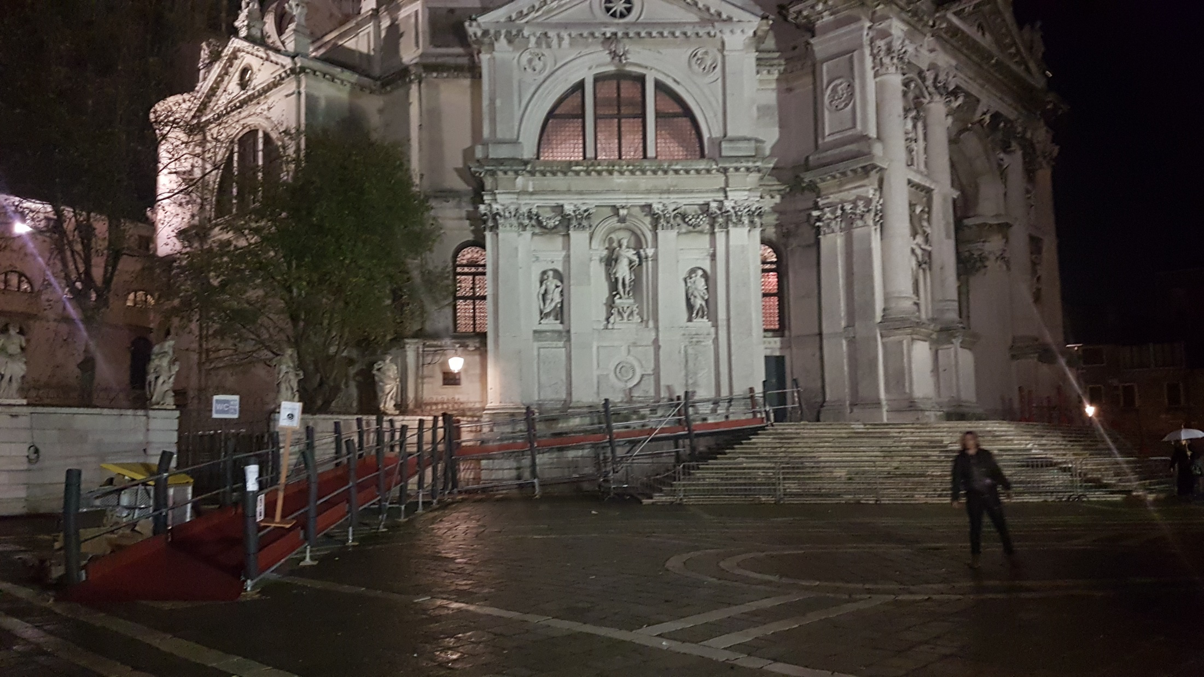
How NOT to do it Location: Church of the Salute, Venice
Pete Kercher – Hasselt – 05 November 2019

Slide 31
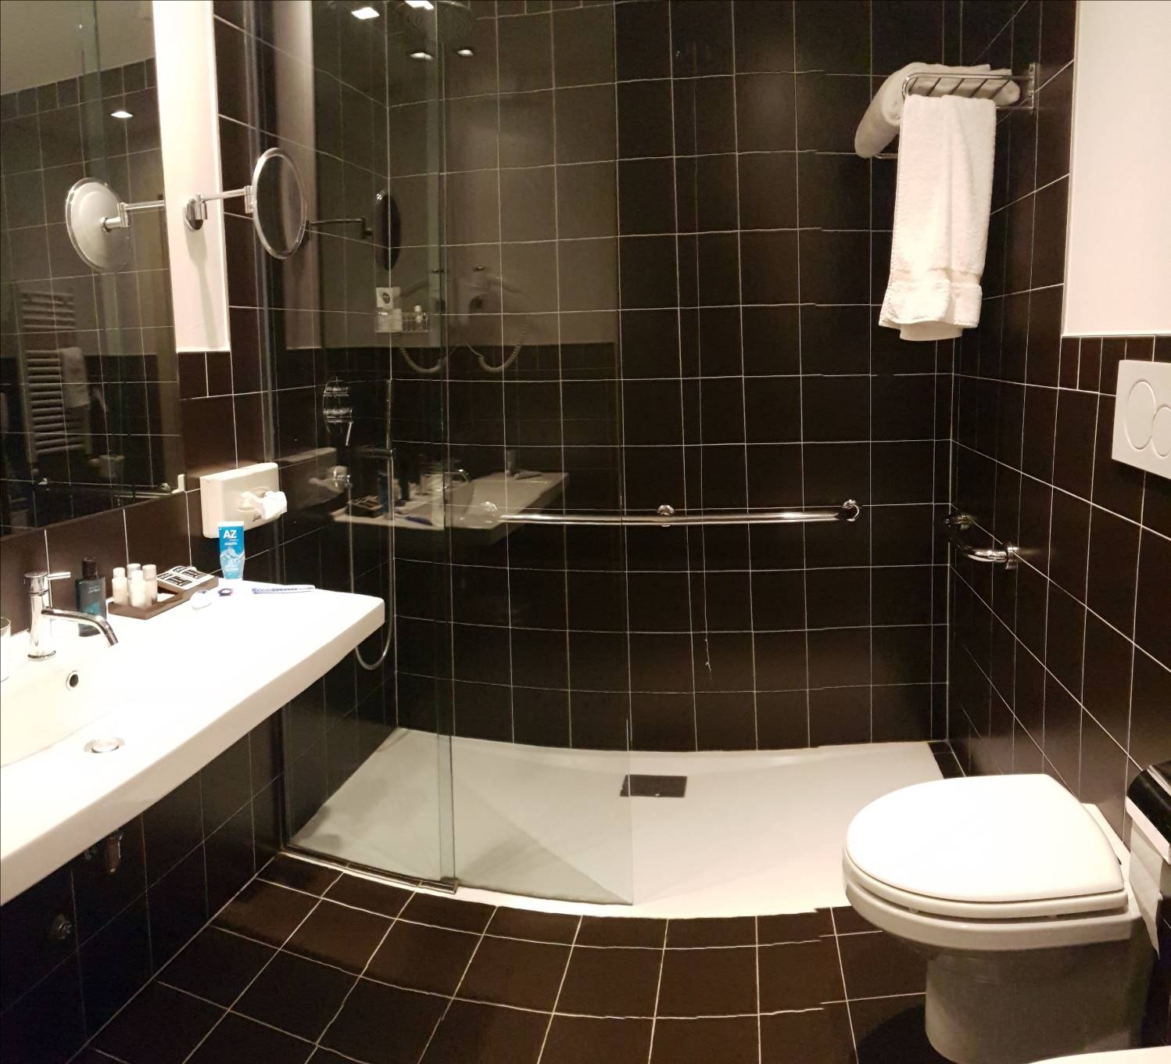
bathrooms can be both accessible and aesthetically pleasing Location: Grand Hotel San Marino
Pete Kercher – Hasselt – 05 November 2019

Slide 32
There are two ways to look at human diversity: - as a “problem” to be solved - as a challenge to creativity and innovation
Pete Kercher – Hasselt – 05 November 2019

Slide 33
So… Should we keep on talking about “removing architectural barriers”? Or should we be talking about “creating new itineraries”?
Pete Kercher – Hasselt – 05 November 2019

Slide 34
Removing barriers | Creating new itineraries
Compliance with laws and standards | Creativity beyond compliance
Ghetto-like toilets “for the disabled” | Inclusive and diversified toilets for all
Watertight container (“silo”) thinking | Holistic, lateral thinking
Experts know everything | Experts consult with experiencers
Physical accessibility | All-round accessibility: availability
Classical ergonomics | Holistic ergonomics
Basic needs and requirements | Human dreams and aspirations
Problem-solving | Innovative responses to challenges
Mere contentment | The right to happiness
Design for disability | Design for All
Pete Kercher – Hasselt – 05 November 2019

Slide 35
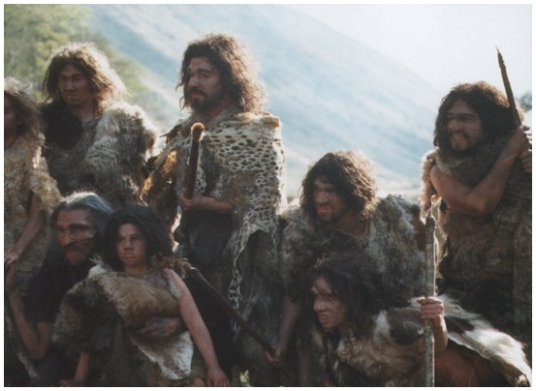
The human society paradigm: this is where we come from…
Pete Kercher – Hasselt – 05 November 2019

Slide 36
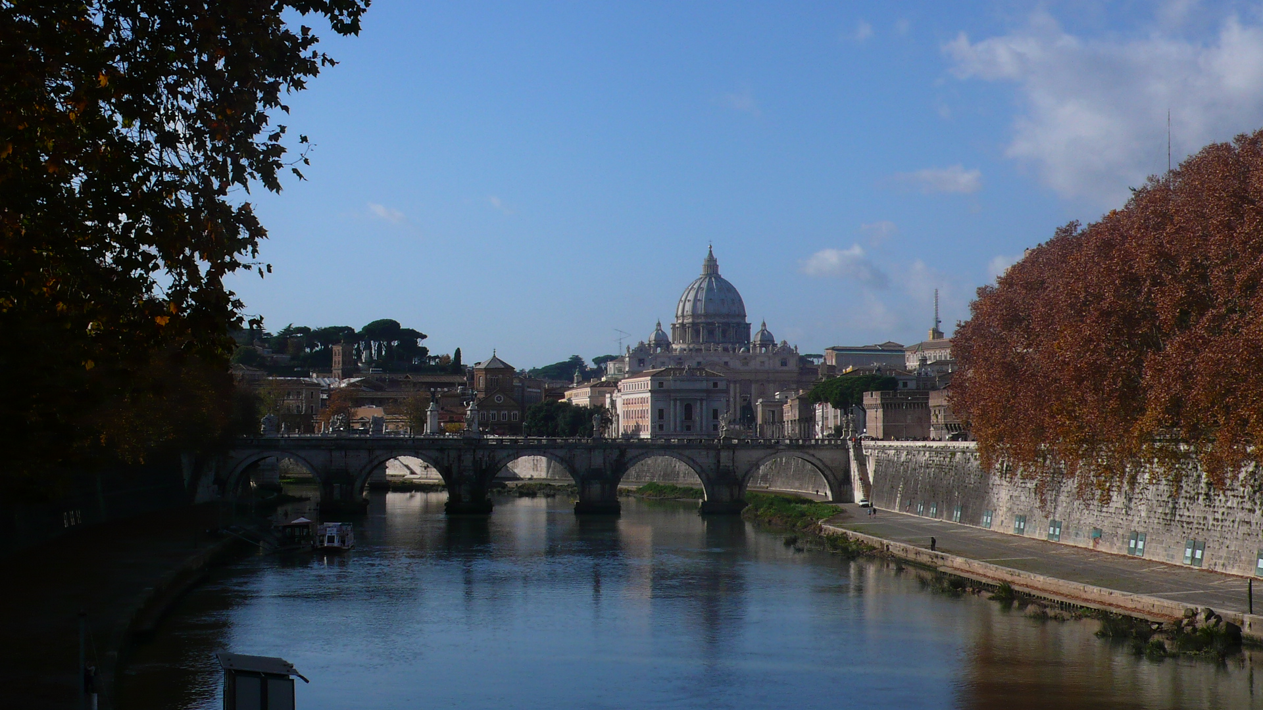
…and this is what we have built.
Pete Kercher – Hasselt – 05 November 2019

Slide 37
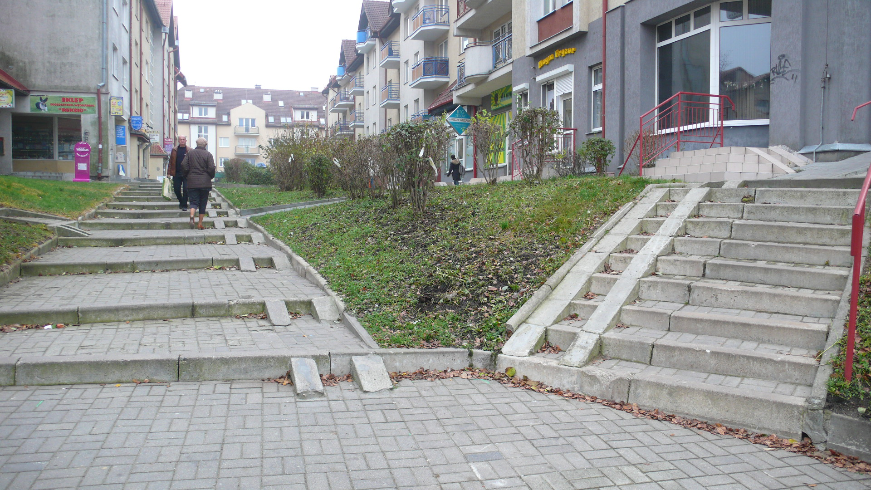
…as is this.
Pete Kercher – Hasselt – 05 November 2019

Slide 38
“The reasonable man adapts himself to the world; the unreasonable one persists in trying to adapt the world to himself. Therefore, all progress depends on the unreasonable man.” George Bernard Shaw
Pete Kercher – Hasselt – 05 November 2019

Slide 39
The big question: what is design?
Pete Kercher – Hasselt – 05 November 2019

Slide 40
A common concept of “design”: luxurious, expensive, superfluous, not very useful or usable
Pete Kercher – Hasselt – 05 November 2019

Slide 41
“A plan or scheme conceived in the mind and intended for subsequent execution” Source: Oxford English Dictionary
Pete Kercher – Hasselt – 05 November 2019

Slide 42
…the oldest description of design used by the design community itself: “Form follows Function” Louis Sullivan
Pete Kercher – Hasselt – 05 November 2019

Slide 43
“the transformation of existing conditions into preferred ones” Herbert Simon
Pete Kercher – Hasselt – 05 November 2019

Slide 44
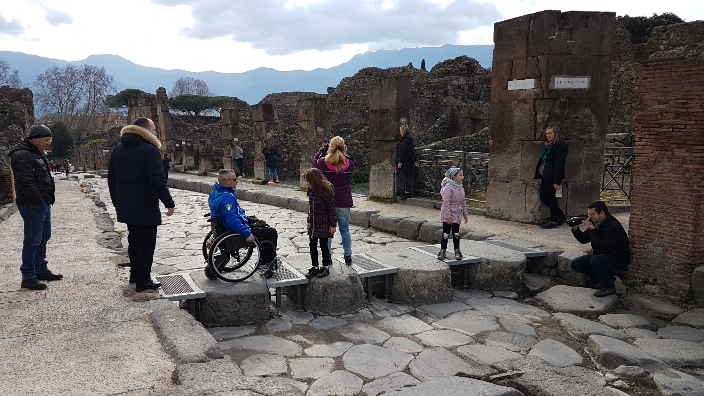
Pompeii: the new accessible route
Pete Kercher – Hasselt – 05 November 2019

Slide 45
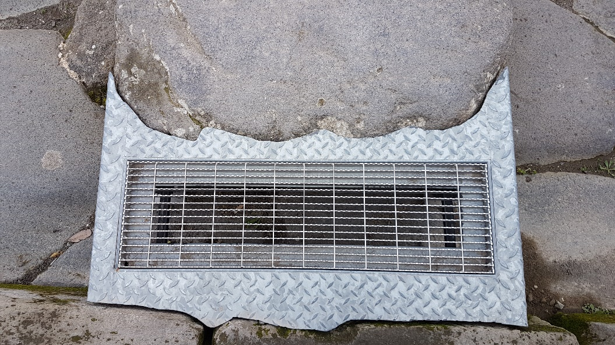
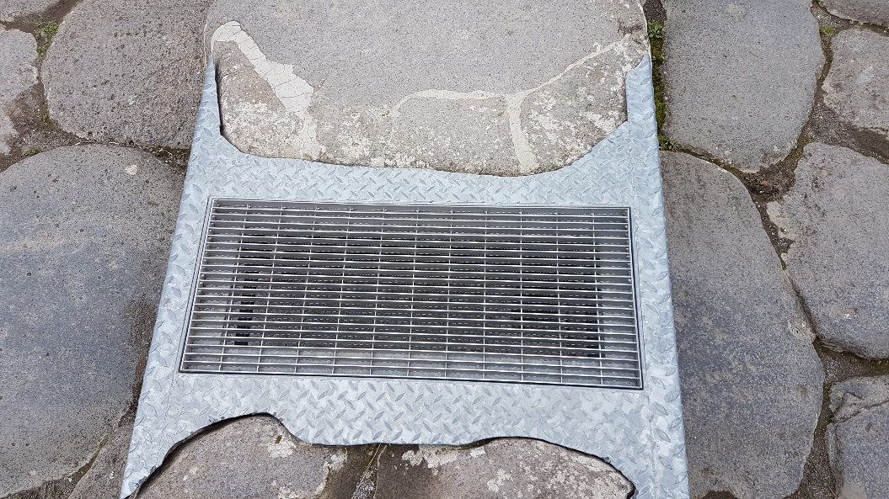
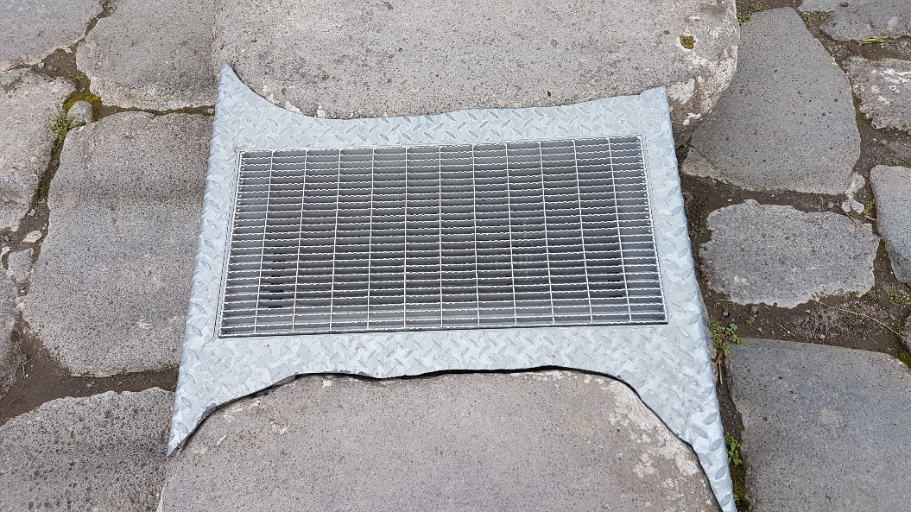
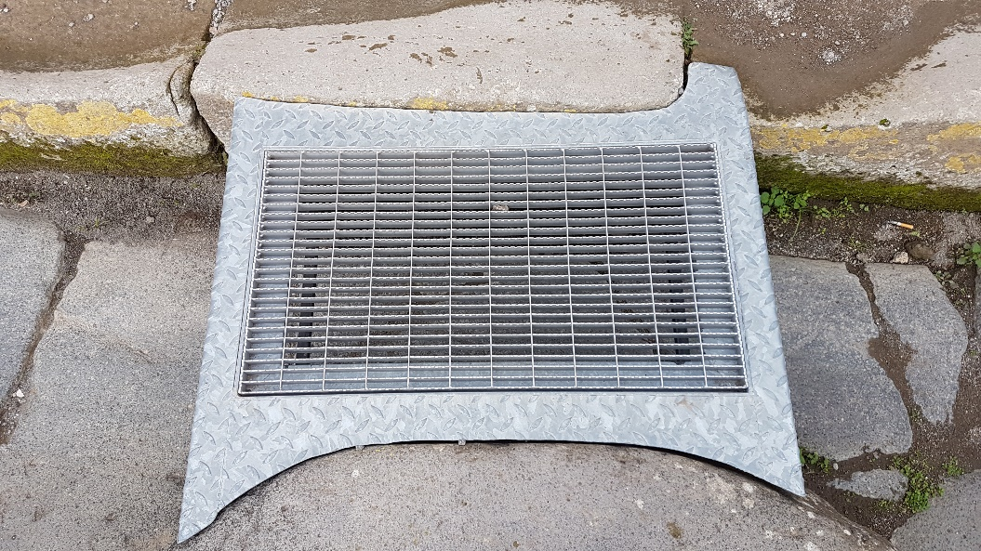
Pompeii: the new accessible route, details
Pete Kercher – Hasselt – 05 November 2019

Slide 46
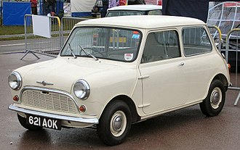
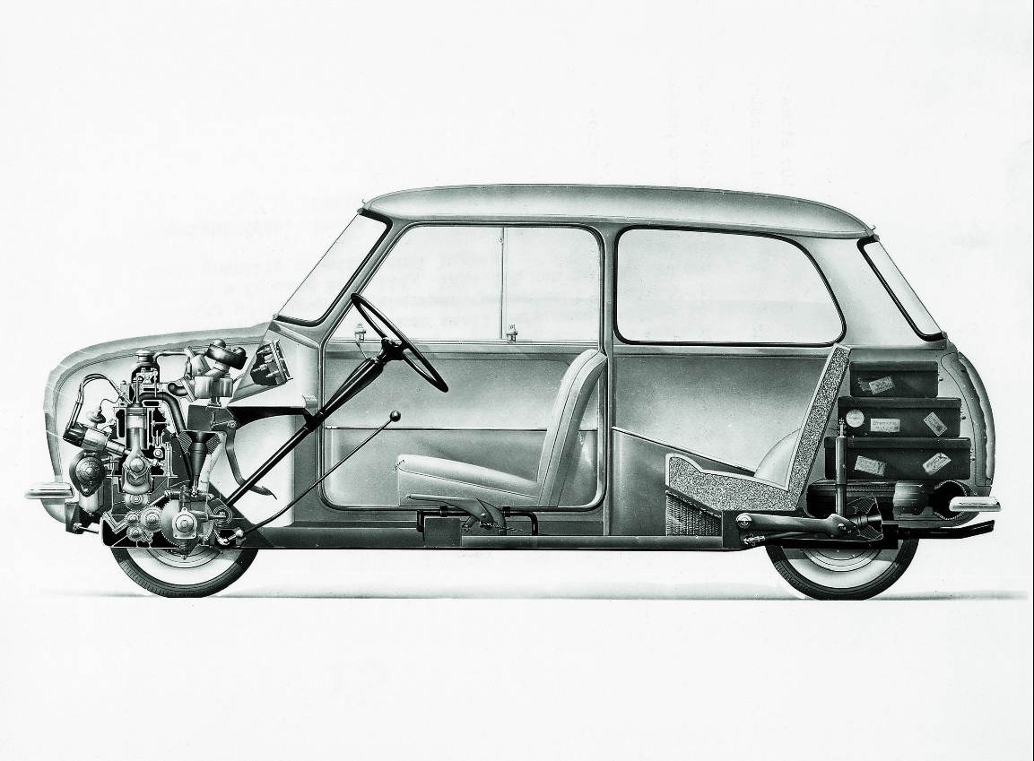
Design innovation: Alex Issigonis and the original mini
Pete Kercher – Hasselt – 05 November 2019

Slide 47
Why adapt how we think about how we live?
Pete Kercher – Hasselt – 05 November 2019

Slide 48
People with disabilities in Italy 2014: 6.7% of the population = 4.1 million 2020: 7.9% of the population = 4.8 million 2040: 10.7% of the population = 6.7 million Source: Censis, Press release dated 3 May 2014 - http://www.censis.it/7?shadow_comunicato_stampa=120959
Pete Kercher – Hasselt – 05 November 2019

Slide 49
People with disabilities in the EU28 2014: an estimated 16.0% of the population = 80 million Source: European Union Agency for Fundamental Rights - http://fra.europa.eu/en/theme/people-disabilities Accessible tourism is worth €800 billion per annum Source: UNWTO Conference on Accessible Tourism in Europe, Republic of San Marino, 19-20 November 2014
Pete Kercher – Hasselt – 05 November 2019

Slide 50
Then there is demographic change: Accessibility concerns us all, not only those with a disability recognised by the state
Pete Kercher – Hasselt – 05 November 2019

Slide 51
European Population Statistics
 | 2004 | 2050 | Change
Overall population | 456,8 m | 449,8 m | - 1,5%
Working age population | 67,2% | 56,7% | - 52,2 m
Children (0-14 years) | 16,4% | 13,4%
Elderly (65+) | 16,4% | 29,9% | + 59,2 m
Very elderly (80+) | 4,0% | 11,4%
Elderly dependence ratio | 24,5% | 52,8%
Young dependence ratio | 24,4% | 23,7%
Total dependence ratio | 48,9% | 76,5%
Highest proportions of 80+ in 2050:
Italy: 14,1%
Germany: 13,6%
Source: Eurostat 2005
Pete Kercher – Hasselt – 05 November 2019

Slide 52
Belgian Population Statistics
 | 2009 | 2050 | Change
Overall population | 10.647 m | 11.493 m | + 7.95%
Working age population | 65,4% | 53,3% | - 0.837 m
Children (0-14 years) | 16,8% | 16,0%
Elderly (60+) | 23,0% | 32,3% | + 1.263 m
Very elderly (80+) | 4,9% | 10,8% | + 0.720 m
Elderly dependence ratio | 35,2% | 60,6%
Young dependence ratio | 25,7% | 30,0%
Total dependence ratio | 60,9% | 90,6%
Source: Population Division, Department of Economic and Social Affairs, United Nations Secretariat, World Population Prospects, The 2008 Revision. Figures elaborated by P. Kercher.
Pete Kercher – Hasselt – 05 November 2019

Slide 53
Italian Population Statistics
 | 2009 | 2050 | Change
Overall population | 59.870 m | 57.066 m | - 4,68%
Working age population | 65,4% | 53,3% | - 8.898 m
Children (0-14 years) | 14,2% | 13,5%
Elderly (65+) | 20,4% | 33,3% | + 6.692 m
Very elderly (80+) | 6,0% | 13,4% | + 4.075 m
Elderly dependence ratio | 31,2% | 62,2%
Young dependence ratio | 21,7% | 25,3%
Total dependence ratio | 52,9% | 87,5%
Source: Population Division, Department of Economic and Social Affairs, United Nations Secretariat, World Population Prospects, The 2008 Revision. Figures elaborated by P. Kercher.
Pete Kercher – Hasselt – 05 November 2019

Slide 54
Portuguese Population Statistics
 | 2009 | 2050 | Change
Overall population | 10.707 m | 10.015 m | - 0.06%
Working age population | 61.4% | 48.3% | - 1.737 m
Children (0-14 years) | 15.3% | 13.3%
Elderly (60+) | 23.3% | 38.4% | + 1.351 m
Very elderly (80+) | 4.4% | 11.0% | + 0.631 m
Elderly dependence ratio | 37.9% | 79.5%
Young dependence ratio | 24.9% | 27.5%
Total dependence ratio | 62.8% | 107.0%
Source: Population Division, Department of Economic and Social Affairs, United Nations Secretariat, World Population Prospects, The 2008 Revision. Figures elaborated by P. Kercher.
Pete Kercher – Hasselt – 05 November 2019

Slide 55
Turkish Population Statistics
 | 2009 | 2050 | Change
Overall population | 74.816 m | 97.389 m | +30,17%
Working age population (15-60 years) | 64,4% | 58,0% | - 6,4%
Children (0-14 years) | 26,8% | 17,6% | -9,2%
Elderly (60+) | 8,8% | 24,4% | + 17.176 m
Very elderly (80+) | 0,8% | 3,7%
Elderly dependence ratio | 13,7% | 42,1%
Young dependence ratio | 41,6% | 30,3%
Total dependence ratio | 55,3% | 72,4%
Source: Population Division, Department of Economic and Social Affairs, United Nations Secretariat, World Population Prospects, The 2008 Revision
Pete Kercher – Hasselt – 05 November 2019

Slide 56
US Population Statistics
 | 2009 | 2050 | Change
Overall population | 314.659 m | 403.932 m | + 28.37%
Working age population | 61.8% | 55.6% | + 30.127 m
Children (0-14 years) | 20.3% | 17.1%
Elderly (60+) | 17.9% | 27.4% | + 54.353 m
Very elderly (80+) | 3.8% | 7.8% | + 19.550 m
Elderly dependence ratio | 28.9% | 49.3%
Young dependence ratio | 32.8% | 30.8%
Total dependence ratio | 61.7% | 80.1%
Source: Population Division, Department of Economic and Social Affairs, United Nations Secretariat, World Population Prospects, The 2008 Revision. Figures elaborated by P. Kercher.
Pete Kercher – Hasselt – 05 November 2019

Slide 57
Chinese Population Statistics
 | 2009 | 2050 | Change
Overall population | 1.345.731 m | 1.417.045 m | + 5.30%
Working age population | 67.9% | 53.7% | - 152.788 m
Children (0-14 years) | 20.2% | 15.3%
Elderly (60+) | 11.9% | 31.1% | + 280.559 m
Very elderly (80+) | 1.4% | 7.2% | + 83.187 m
Elderly dependence ratio | 17.5% | 57.9%
Young dependence ratio | 40.0% | 28.5%
Total dependence ratio | 57.5% | 86.4%
Source: Population Division, Department of Economic and Social Affairs, United Nations Secretariat, World Population Prospects, The 2008 Revision. Figures elaborated by P. Kercher.
Pete Kercher – Hasselt – 05 November 2019

Slide 58
Brazilian Population Statistics
 | 2009 | 2050 | Change
Overall population | 193.734 m | 217.512 m | + 12.27%
Working age population | 64.2% | 56.0% | - 2.570 m
Children (0-14 years) | 25.9% | 14.7%
Elderly (60+) | 9.9% | 29.3% | + 44.551 m
Very elderly (80+) | 1.4% | 6.5% | + 11.426 m
Elderly dependence ratio | 15.4% | 52.3%
Young dependence ratio | 40.4% | 26.3%
Total dependence ratio | 55.8% | 78.8%
Source: Population Division, Department of Economic and Social Affairs, United Nations Secretariat, World Population Prospects, The 2008 Revision. Figures elaborated by P. Kercher.
Pete Kercher – Hasselt – 05 November 2019

Slide 59
Korean Population Statistics
 | 2009 | 2050 | Change
Overall population | 48.333 m | 44.077 m | - 8.8%
Working age population | 68.1% | 47.8% | - 11.926 m
Children (0-14 years) | 16.8% | 11.4%
Elderly (60+) | 15.1% | 40.8% | + 10.685 m
Very elderly (80+) | 1.9% | 12.7% | + 4.680 m
Elderly dependence ratio | 22.6% | 85.4%
Young dependence ratio | 24.7% | 23.8%
Total dependence ratio | 47.3% | 109.2%
Source: Population Division, Department of Economic and Social Affairs, United Nations Secretariat, World Population Prospects, The 2008 Revision. Figures elaborated by P. Kercher.
Pete Kercher – Hasselt – 05 November 2019

Slide 60
The three most frequent barriers are prejudicial responses: “It cannot be done” “It is too expensive” “We’ve always done it that way”
Pete Kercher – Hasselt – 05 November 2019

Slide 61
The first is an error in design thinking. “Impossible” means you are not thinking outside the box: your mindset is too narrow, you have not exhausted the options. “Impossible” is not part of the creative’s vocabulary.
Pete Kercher – Hasselt – 05 November 2019

Slide 62
The second is an error in accounting practice: “The art of economics consists in looking not merely at the immediate but at the longer effects of any act or policy; it consists in tracing the consequences of that policy not merely for one group but for all groups.” Source: Henry Hazlitt, Economics in One Lesson, 1946
Pete Kercher – Hasselt – 05 November 2019

Slide 63
The principle: rethinking the concept of Return on Investments in our places, products, communications and systems as an investment in quality of life, positive experience and happiness to reduce healthcare costs generated by depression among the elderly
Pete Kercher – Hasselt – 05 November 2019

Slide 64
How? Accessibility and Design for All in society and culture enable participation Participation enables socialisation Socialisation generates endorphin neurotransmitters Endorphins stave off the development of depression and the resulting psychosomatic conditions and physical pathologies A reduction in psychosomatic and physical pathologies means lower healthcare costs
Pete Kercher – Hasselt – 05 November 2019

Slide 65
The third is a sign of fear of change. It is intrinsically conservative: the opposite of innovation.
Pete Kercher – Hasselt – 05 November 2019

Slide 66
Every chain is only as strong as its weakest link.
Pete Kercher – Hasselt – 05 November 2019

Slide 67
Thankyou for your attention www.dfaeurope.eu strategicdesign@ksdc.eu
Pete Kercher – Hasselt – 05 November 2019

Slide 68
3. Panelgesprek
Moderator Nele Bylois, speerpuntonderzoeker vrijetijdseconomie
PXL Expertisecentrum Innovatief ondernemen

Slide 69
Voorstelling panelleden
Evy Houbrechts, zaakvoerder, B&B Barber
Wilfried Vantyghem, manager, Domein Polderwind
Bea Geboers, interior designer, Polo Architects
Marc Vandeneynde, toerisme expert, We travel2

Slide 70
Panelgesprek
Motivatie tot deelname

Slide 71
Panelgesprek: Stelling 1
Ondernemen met aandacht voor inclusie is niet haalbaar
voor kleine ondernemingen.

Slide 72
Panelgesprek: Stelling 2
Inclusie is een opportuniteit om ook in dalmomenten
voldoende boekingen te realiseren.

Slide 73
Panelgesprek: Stelling 3
Het is onmogelijk om aan de behoeften van iedereen te voldoen.

Slide 74
Panelgesprek: Stelling 4
Aanpassingen in mijn kamers of aan mijn producten zijn zichtbaar
en schrikken de ‘gewone’ toerist/gebruiker af.

Slide 75
Panelgesprek: Stelling 5
Gezien de maatschappelijke veranderingen kunnen wij als onderneming
niet anders dan inspelen op inclusie.

Slide 76
Panelgesprek: Stelling 6
Het huidige logies/productaanbod voldoet niet aan
de verwachtingen van de gast/gebruiker met inclusienoden.

Slide 77
Panelgesprek: Stelling 7
Ondernemers die de inclusiegedachte inkantelen in hun bedrijf hebben meer omzet?!

Slide 78
4. Toelichting Tetra-project Inclusief toerisme als businesstransformator
door Evi Knuts, projectcoördinator
PXL Expertisecentrum Innovatief ondernemen

Slide 79
Context van buiten naar binnen: trends, opportuniteiten, uitdagingen
Verdere professionalisering voor een hogere instroom van gasten
Seizoensverlenging
Een sterk multidisciplinair, gepersonaliseerd aanbod voor doelgroepen
Aandacht en ondersteuning voor groei van (logies)ondernemers
Trendverschuiving van belevingstoerisme naar duurzaam betekenisvol toerisme
Stimuleren van toenemende samenwerking over sectoren heen
Nood aan betere profilering van het aanbod en USP’s van logies
Notes:
Tourism for all beleidsplan

Slide 80
Context van binnen naar buiten: expertise over sectoren heen slim inzetten
PXL Expertisecentrum Innovatief ondernemen
Professionaliseringstraject kleinschalige logies
Kwaliteitsaudits
Doelgroepdiversificatie
Accentgastronomy
PXL Expertisecentrum Zorginnovatie
UD Woonlabo
Universal Design for tourism
Workshop Universal Design Hotelrooms
Presentatie Destinations for all World summit
Arck Uhasselt
Designing for More
Inclusief & mensgericht ontwerpend onderzoek
Doctoraat: Kennisopbouw inclusieve ontwerpprocessen
Onderzoek "Directe kosten en baten Integraal Toegankelijke gebouwen in Vlaanderen"

Slide 81
Wat is tetra?
Doel
recent beschikbare kennis vertalen in concrete, nuttige informatie zodat de doelgroep sneller en efficiënter kan innoveren
Doelgroep
Begeleidingsgroep die bestaat uit Vlaamse ondernemingen /non profitorganisaties die een actieve rol hebben
Brede groep Vlaamse ondernemingen/non profitorganisaties die de kennis vernemen en/of zullen toepassen
Kennistransfer
Toegevoegde waarde en kennisdoorstroming naar docenten, studenten en onderzoekers
www.vlaio.be/tetra

Slide 82
Ons gemeenschappelijk doel inclusief toerisme als businesstransformator
Bestaande Universal Design (UD)-principes implementeren bij logiesverstrekkers en toeleveringsbedrijven op basis van een
- UD opportuniteitenscreening
- Businesstransformatie-oefening
-> UD-opportuniteiten herkennen, integreren, vermarkten
Het valideren van de UD-aanpak via een roadmap

Slide 83
Ons gemeenschappelijk doel inclusief toerisme als businesstransformator
Inclusief toerisme
‘Toegankelijk toerisme of incusief toerisme is een vorm van toerisme waarbij samenwerkingsvormen tussen verschillende stakeholders ervoor zorgen dat personen met toegankelijksheidsvragen met name betreffende mobiliteit, zicht, gehoor en andere cognitieve dimensies onafhankelijk, als gelijken en waardig kunnen functioneren via een universeel ontworpen toeristisch aanbod (producten, diensten en omgeving). Deze definitie integreert een levenslang proces waardoor personen gedurende hun levensloop kunnen genieten van een toegankelijk toeristisch aanbod.

Slide 84
Ons gemeenschappelijk doel het vertrekpunt: inclusief toerisme als businesstransformator
Businesstranformator
Het transformeren van een organisatie door middel van het toepassen van vernieuwende methodologiëen en integreren van nieuwe kennis met als doel het versterken, professionaliseren en innoveren van het bestaande businessplan

Slide 85
Doelgroepen
Logiesverstrekkers
Toeleveringsbedrijven
Overheden en beleidsorganisaties
Eindgebruikers

Slide 86
Doelgroepen logiesverstrekkers
Primaire doelgroep
B&B
Hotel(keten)

Slide 87
Doelgroepen Toeleveringsbedrijven
Leveren producten/diensten met impact op gasten in logies
Vb. ruimtelijke ontwerpers, diverse producenten/verdelers van servies, beddengoed, sectororganisaties

Slide 88
Actieplan
Duurtijd project: 2 jaar 1/10/19 – 30/9/2021
5 werkpakketten
Begeleidingsgroep
Volgen via www.udwoonlabo.be

Slide 89
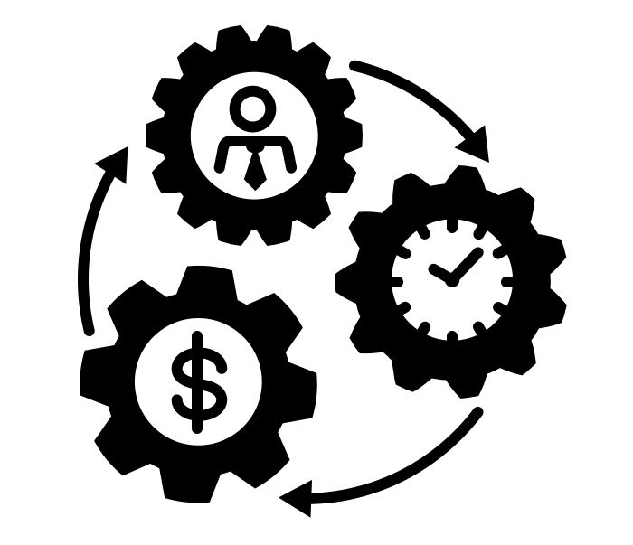
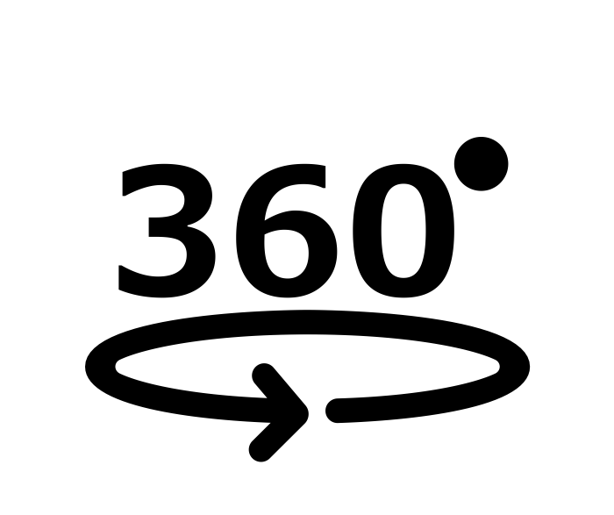
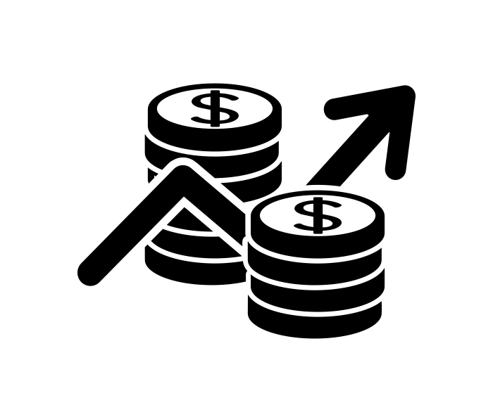
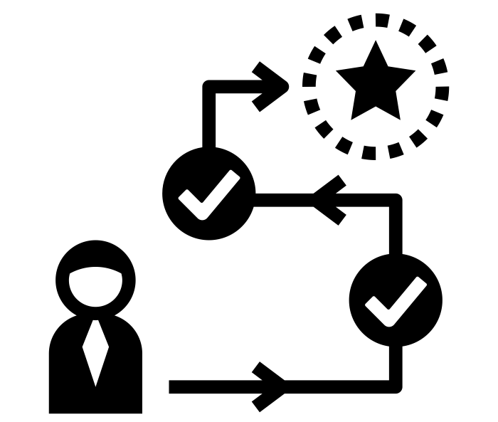
WP 1: PROJECTMANAGEMENT
WP 2:
UD SCAN EN OPTIMALISATIERAPPORT
WP 3:
UD OPPORTUNITEITEN MATRIX
WP 4:
UD IMPLEMENTATIEPLAN
Opstellen UD scan
Logiesverstrekkers
Bedrijven
360° scan as-is op 3 niveaus
Quick scan regulier aanbod
Opstellen UD Opportuniteitenmatrix casestudies
Opstellen implementatieplan bij casestudies (logiesverstrekkers)
Co-creatiesessies met casestudies
Afname UD scan en optimalisatie
Prioritisering opportuniteiten bij casestudies
Co-creatiesessies met casestudies
Opstellen van roadmap
Opstellen optimalisatierapport
Terugkoppeling
generieke matrix naar
lerend netwerk
Terugkoppeling van de roadmap naar
lerend netwerk
Terugkoppeling generieke resultaten naar
lerend netwerk
WP 5: VALORISATIE

Slide 90
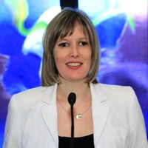
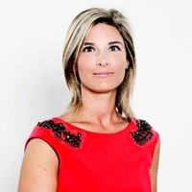
Projectteam
Nele Bylois
Onderzoeker vrijetijdseconomie
PXL Expertisecentrum Innovatief ondernemen
Anouk Tuinstra
Onderzoeker UD Woonlabo
PXL Expertisecentrum Zorginnovatie
Elke Ielegems
dr. Architect onderzoeker
Faculteit Architectuur en Kunst
UHasselt
Ryanne Lemmens
Onderzoeker
PXL Expertisecentrum Zorginnovatie
Evi Knuts
Onderzoekshoofd
PXL Expertisecentrum Innovatief ondernemen
Multidisciplinaire expertise

Slide 91
Begeleidingsgroep
Klankbordfunctie
Co-creatiepartner
Waarnemend partner

Slide 92
Begeleidingsgroep Klankbordfunctie
Lerend netwerk 2x/jaar (totaal 4x)
Nieuwe kennis- en toepassingsmogelijkheden verwerven
Feedback geven op projectverloop
Vrijblijvende deelname aan focusgroepen, workshops en inspiratiesessies
Deelnameprijs: € 500 op jaarbasis

Slide 93
Begeleidingsgroep Co-creatiepartner logiesuitbater
Businesscase uitwerken als businesstransformatie
→ UD Scan
→ Opportuniteitenscreening inclusief toerisme
→ UD Implementatieplan
Contactmomenten → Individueel 4 → Lerend netwerk: focusgroepen, co-creatiesessies → Begeleidingsgroep 2x/jaar
Deelnameprijs
€ 1400 B&B - € 2400 Hotel(keten) op jaarbasis

Slide 94
Begeleidingsgroep Co-creatiepartner toeleveringsbedrijf
Businesscase uitwerken als businesstransformatie
→ UD Scan inclusief toerisme
→ Opportuniteitenscreening
Contactmomenten → Individueel 2 → Lerend netwerk: focusgroep → Begeleidingsgroep 2x/jaar
Deelnameprijs
<20 medewerkers € 350 op jaarbasis >20 medewerkers € 1000 op jaarbasis

Slide 95
Begeleidingsgroep Waarnemend partner
Enkel bestemd voor doelgroep 3. Overheidsorganisaties
Vrijblijvende deelname begeleidingsgroep 2x/jaar

Slide 96
Informatiebundel
Intentieverklaring
Reglement van orde – template Wordt persoonlijk via mail verstuurd
Brochures
Gepersonaliseerd attest van deelname

Slide 97
5. Vraag en antwoord
Contactgegevens projectcoördinator: Evi Knuts
Evi.knuts@pxl.be
0479/28.48.23
Extra info over samenwerken met hogescholen?
www.blikopener.be
Notes:
Contactgegevens

Slide 98
6. Receptie en netwerking
door PXL Catering

